Slide 1

DEPARTMENT OF COMPUTER SCIENCE & ENGINEERING
SCHOOL OF COMPUTING
1156CS701- MAJOR PROJECT(INHOUSE)
WINTER SEMESTER 2023-2024
REVIEW - II
“Cyberattack Identification and Localization Using Adaptive Hierarchical Approach in Active Distribution Systems ”
SUPERVISED BY
Dr .S.RAVIKUMAR.
Associate Professor.
PRESENTED BY
1. MOHAMMAD AFROZ (16850)(20UECS0616)
2. D M PHANI BHUSHAN (16937)(20UECS0218)
3. G C SASI KANTH (12412)(20UECS0281)

Slide 2
AGENDA
ABSTRACT
OBJECTIVE
INTRODUCTION
LITERATURE REVIEW
DESIGN AND METHODOLOGIES
IMPLEMENTATION
TESTING
INPUT AND OUTPUT
DEMO VIDEO
CONCLUSION
PLAGIARISM REPORT OF PPT
REFERENCES

Slide 3
ABSTRACT
Integration of advanced technologies into distribution systems increases vulnerability to cyber attacks.
Proposed adaptive hierarchical approach for cyber attack detection and localization aims to enhance resilience of active distribution systems.
Hierarchical structure allows efficient processing and analysis of diverse data sources like smart meters, sensors, and SCADA systems.
Machine learning algorithms enable continuous learning from historical data to improve detection capabilities and counter emerging threats.
System utilizes hierarchical layers to localize detected attacks, facilitating swift response and mitigation measures.
Effectiveness of approach validated through simulation studies on realistic distribution system models, demonstrating potential to bolster security against evolving cyber threats.

Slide 4
OBJECTIVES
Aim of the Project:
Develop algorithms and methods to detect cyber attacks targeting active distribution systems.
Design techniques to pinpoint the location of cyber attacks within the distribution system.
Scope of the Project:
System Architecture Design: This would involve designing the overall architecture of the detection and localization system. integration with existing control systems, communication protocols, and hardware requirements.
Cyber Attack Detection Algorithms: Developing algorithms to detect cyber attacks on the distribution system. These could include anomaly detection techniques, machine learning algorithms, or signature-based detection methods.

Slide 5
INTRODUCTION
The rapid advancement of digital technologies has revolutionized power distribution systems, leading to the emergence of active distribution networks (ADNs) characterized by bidirectional power flows, distributed energy resources (DERs), and enhanced monitoring and control capabilities.
While these advancements promise greater efficiency, reliability, and sustainability, they also introduce new challenges, particularly in cybersecurity.
Cyber attacks targeting power distribution systems pose significant threats to grid stability, operational integrity, and the safety of critical infrastructure.
Traditional security measures, often focused on perimeter defense and intrusion detection, are inadequate to protect against sophisticated cyber threats that exploit vulnerabilities across interconnected devices and systems.

Slide 6
LITERATURE REVIEW
H. Zhang, Z. Liu, X. Wang, and Y. Li (2021). "Deep Learning-Based Cyber Attack Detection and Localization in Active Distribution Systems.“
This paper presents a deep learning-based approach for cyber attack detection and localization specifically tailored for active distribution systems. The study explores the use of advanced deep learning models to analyze network data and identify potential cyber threats, contributing to improved security in distribution networks.
A. Patel, R. Gupta, S. Jain, and V. Mishra (2022). "Real-time Anomaly Detection and Localization in Active Distribution Systems Using Reinforcement Learning.”
This research introduces a real-time anomaly detection and localization framework for active distribution systems leveraging reinforcement learning techniques. The study focuses on developing adaptive and responsive systems capable of identifying and localizing anomalies efficiently.

Slide 7
LITERATURE REVIEW
F. Li, Y. Shi, A. Shinde, J. Ye, and W.-Z. Song (2019). "Enhanced Cyber physical Security in Internet of Things through Energy Auditing.“
This research presents an approach to enhance cyberphysical security in the Internet of Things (IoT) by leveraging energy auditing techniques. The study focuses on analyzing energy consumption patterns within IoT systems to detect and mitigate security threats, ultimately improving overall IoT security.
A. J. Wilson, D. R. Reising, R. W. Hay, R. C. Johnson, A. A. Karrar, and T. D. Loveless (2020). "Automated Identification of Electrical Disturbance Waveforms within an Operational Smart Power Grid."
This paper introduces an automated method for identifying electrical disturbance waveforms in smart power grids. By employing automated techniques to analyze power grid data, the study aims to identify specific electrical anomalies efficiently, contributing to the resilience and reliability of smart grid operations.

Slide 8
LITERATURE REVIEW
I. Sadeghkhani, M. E. H. Golshan, A. Mehrizi-Sani, J. M. Guerrero, and A. Ketabi (2016). "Transient Monitoring Function–based Fault Detection for Inverter-interfaced Microgrids.
This paper presents a fault detection method for inverter-interfaced microgrids based on transient monitoring functions. The study focuses on leveraging transient behaviours to detect and diagnose faults in microgrid systems. By utilizing monitoring functions derived from system dynamics, the proposed approach enhances fault detection capabilities in inverter-based microgrids, contributing to system reliability and operational stability.
Imran, S., Harshitha, Chandana, Divija (Year). “Adaptive Hierarchical Cyber Attack Detection and Localization in Active Distribution Systems.”
This research proposes an adaptive hierarchical approach for detecting and localizing cyber attacks in active distribution systems using advanced algorithms. The system integrates data preprocessing, feature extraction, anomaly detection, and hierarchical decision-making to effectively identify and respond to threats. Future work will focus on optimizing performance and validating the system in practical environments.

Slide 9
DESIGN AND METHODOLOGIES
MODULE 1 Hierarchical Cyber Attack Detection
MODULE 2 Cyber Attack Localization
MODULE 3 Real-time Incident Response and Mitigation

Slide 10
DESIGN AND METHODOLOGIES
Module 1: Hierarchical Cyber Attack Detection
Data Collection and Preprocessing:
Gather data from various sources within the active distribution system, including smart meters, sensors, SCADA systems, and communication networks.
Preprocess the data to remove noise, handle missing values, and normalize the features.
Feature Extraction:
Extract relevant features from the preprocessed data, such as power consumption patterns, voltage levels, frequency deviations, and network traffic characteristics.
Utilize advanced techniques like wavelet transforms or Fourier analysis to extract temporal and spectral features.
Anomaly Detection:
Implement machine learning algorithms, such as support vector machines (SVM), random forests, or deep learning models, to detect anomalies in the system behavior.
Train the models using historical data and validate their performance on unseen data to ensure robustness.

Slide 11
DESIGN AND METHODOLOGIES
Module 2: Cyber Attack Localization
Attack Signature Analysis:
Analyze the detected anomalies to identify potential cyber attack signatures, such as characteristic patterns or signatures associated with specific attack types.
Use domain knowledge and expert systems to classify the detected anomalies into different attack categories.
Propagation Analysis:
Investigate the propagation behavior of cyber attacks within the distribution system, including the spread of malicious activities and their impact on network components.
Develop propagation models based on graph theory or network flow analysis to predict the spread of attacks in real-time.
Localization Algorithms:
Design localization algorithms to pinpoint the source and location of cyber attacks within the distribution network.

Slide 12
DESIGN AND METHODOLOGIES
Module 3: Real-time Incident Response and Mitigation:
Real-time Monitoring and Analysis:
Implement a real-time incident response system to monitor network activity and analyze potential threats as they occur.
Utilize streaming data processing technologies for immediate threat detection and response.
Automated Response Actions:
Define automated response actions based on predefined rules and policies to mitigate identified threats.
Ensure adaptive response capabilities that adjust actions based on the severity and nature of detected attacks

Slide 13
IMPLEMENTATION
ARCHITECTURE DIAGRAM
DATA FLOW DIAGRAM
ER DIAGRAM
SEQUENCE DIAGRAM
COLLABORATION DIAGRAM

Slide 14
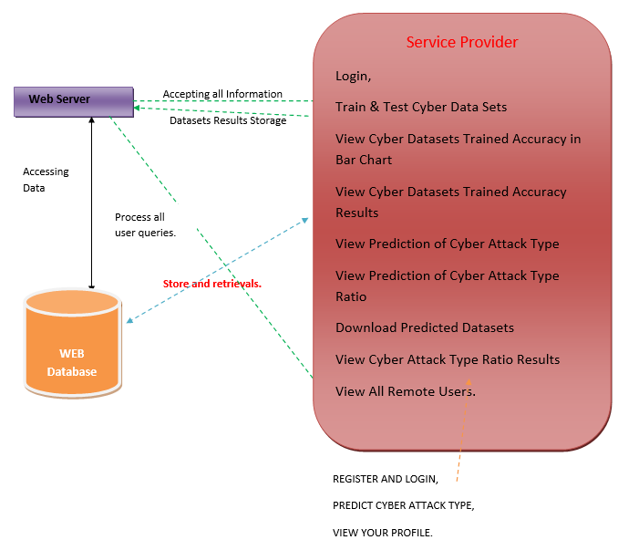
IMPLEMENTATION
ARCHITECTURE DIAGRAM.

Slide 15
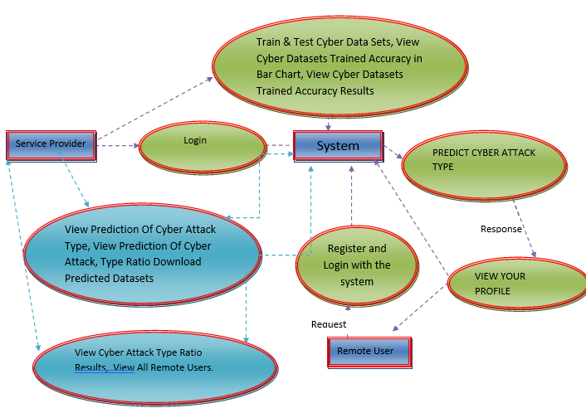
IMPLEMENTATION
DATA FLOW DIAGRAM.

Slide 16
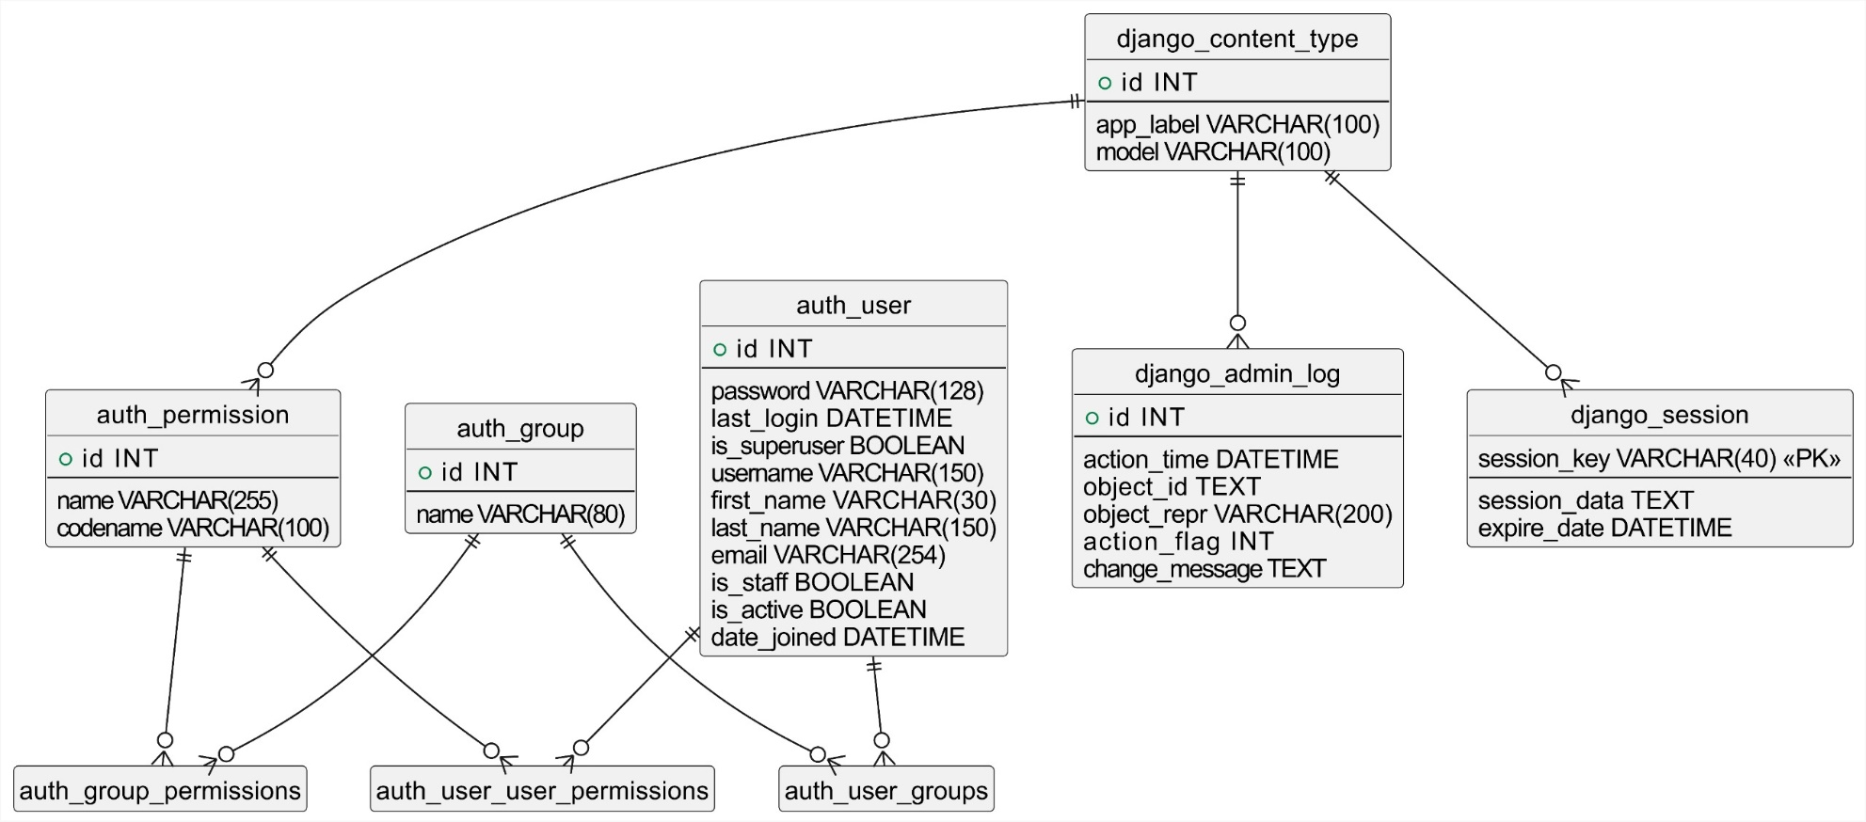
IMPLEMENTATION
ER DIAGRAM.

Slide 17
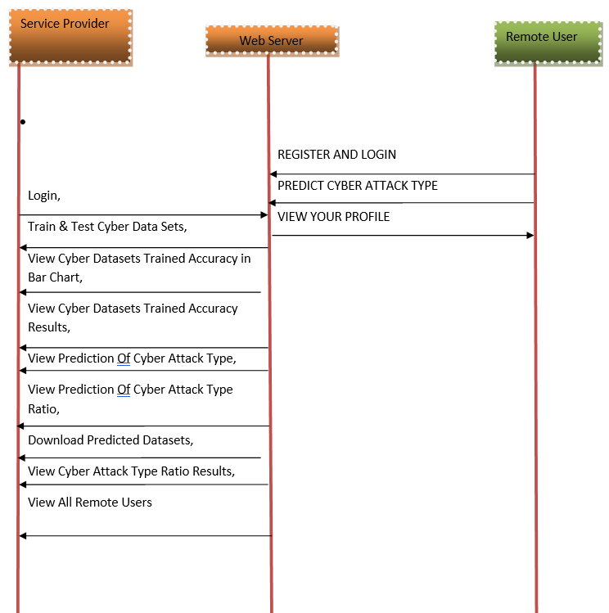
IMPLEMENTATION
SEQUENCE DIAGRAM.

Slide 18
TESTING
UNIT TESTING.
Unit testing was conducted to verify the functionality of individual components such as data parsing, rule engine, and alert generation. For instance, data parsing tests involved feeding raw network packet data to the system and verifying the accuracy of parsed information including IP addresses, port numbers, and protocols. Similarly, the rule engine was tested with different attack rules to validate the system's ability to identify specific types of attacks based on predefined rules, while alert generation tests ensured that actionable alerts were appropriately generated upon detection of suspicious activity.

Slide 19
TESTING
INTEGRATION TESTING.
Integration testing focused on validating interactions between integrated components. This included scenarios such as data parsing coupled with the rule engine to ensure proper identification and rule matching based on parsed network data and attack rules. Furthermore, integration of the rule engine with the alert generation module was tested to verify the seamless generation of alerts based on detected attack information.

Slide 20
TESTING
FUNCTIONAL TESTING.
Functional testing scenarios were designed to evaluate the system's performance and behavior under different attack simulations. For example, a denial-of-service (DoS) attack simulation involved injecting high-volume traffic into the system to test its detection capabilities and verify the generation of alerts for DoS attacks. Additionally, tests for port scanning detection were conducted to identify and respond to port scanning activities within the network.

Slide 21
TESTING
WHITE BOX TESTING.
White box testing aimed to validate the internal logic and code paths of the system. Comprehensive code coverage analysis was performed using various network packet scenarios to ensure that all critical code paths were exercised. Algorithm validation tests included stress testing and edge cases to assess the system's robustness and performance under different loads and conditions.

Slide 22
TESTING
BLACK BOX TESTING.
Black box testing focused on evaluating the system's behavior from an external perspective and user interaction standpoint. This included input-output validation with diverse network packet data to ensure accurate identification of attack types, as well as usability testing of the user interface to ensure intuitive alert management and response.

Slide 23
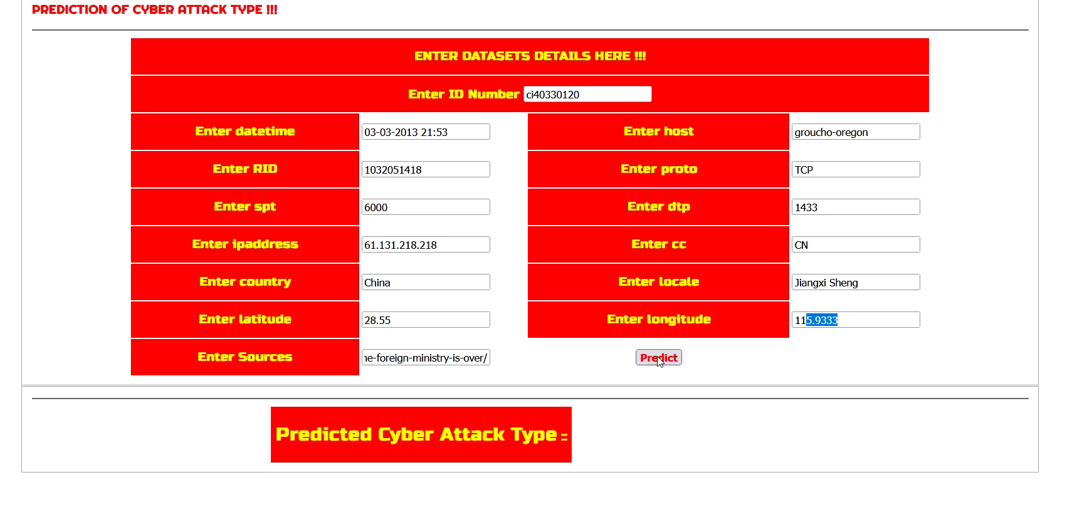
INPUT AND OUTPUT
SCREENSHOTS:
Input Data:

Slide 24
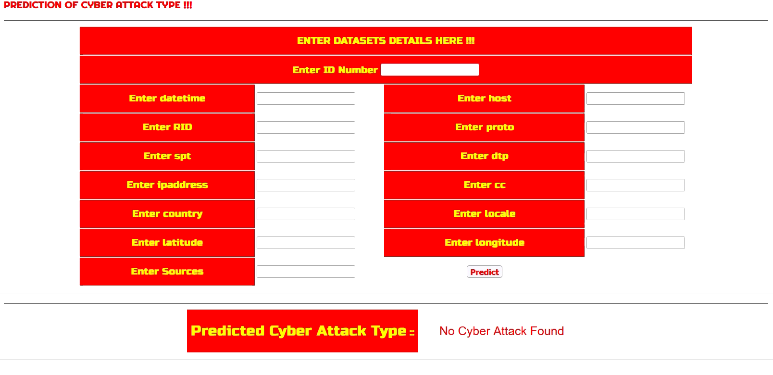
INPUT AND OUTPUT
SCREENSHOTS:
Output Data:

Slide 25
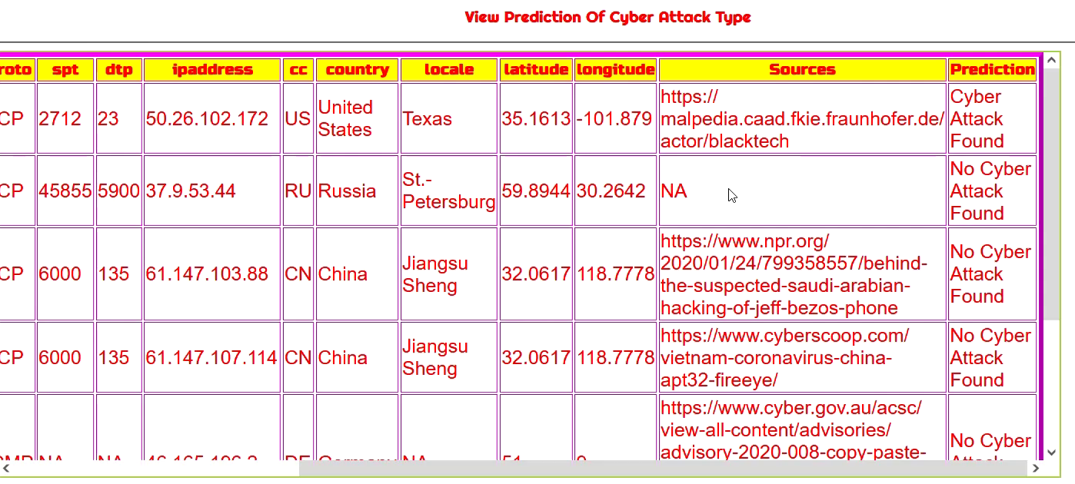
INPUT AND OUTPUT
SCREENSHOTS:
Output Data:

Slide 26
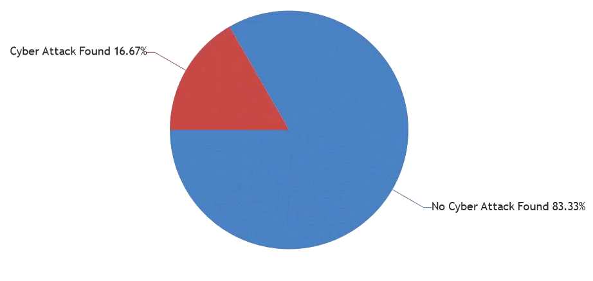
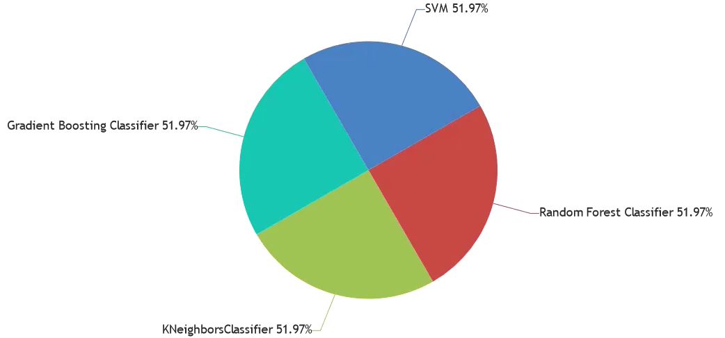
INPUT AND OUTPUT
SCREENSHOTS:
Output Data:

Slide 27
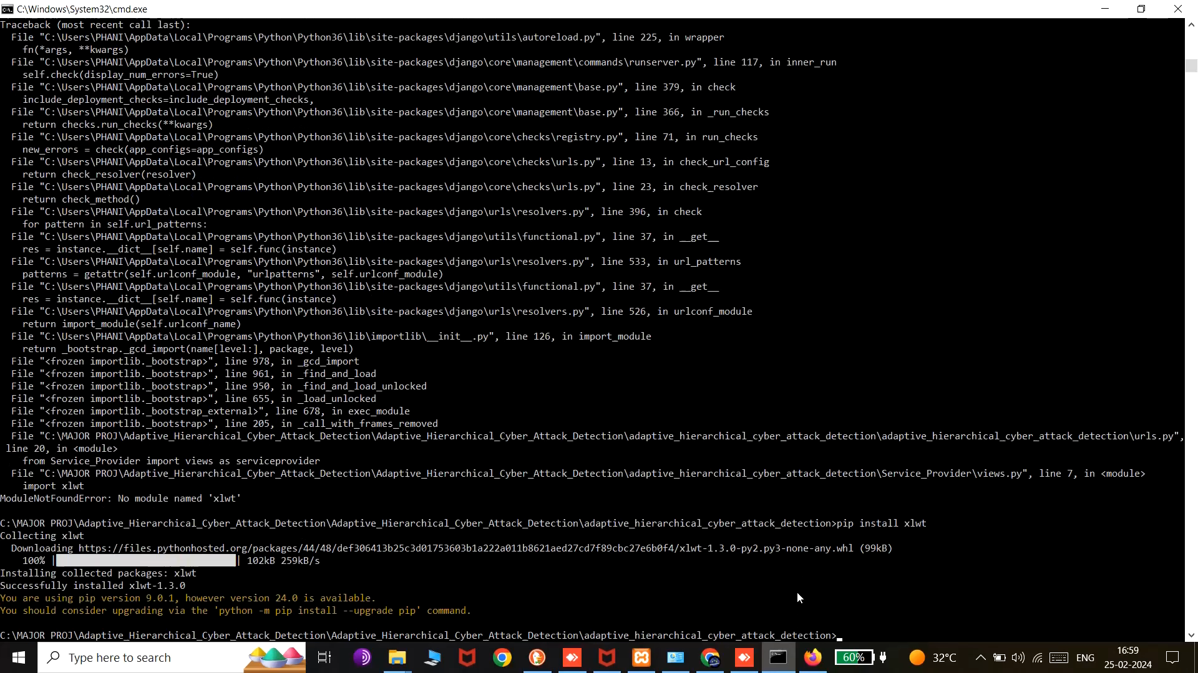
DEMO VEDIO

Slide 28
CONCLUSION
The development of the Cyber Attack Detection System represents a significant advancement in network security, leveraging adaptive algorithms and real-time analysis to enhance threat detection capabilities. This system offers proactive monitoring and rapid response to potential cyber threats through features like rule-based detection and alert generation. By employing an adaptive hierarchical approach in distribution systems, the system effectively analyzes network traffic, identifies suspicious patterns, and localizes potential attacks, providing valuable insights for cybersecurity professionals and network administrators. This project underscores the importance of proactive cybersecurity measures and innovative technologies in safeguarding critical infrastructure and data assets, offering a proactive defense mechanism against emerging threats in dynamic network environments.

Slide 29
REFERENCES
I. Džafi´c, R. A. Jabr, S. Henselmeyer, and T. Ðonlagi´c, 2016, “Fault locationin distribution networks through graph marking,” IEEE Transactions on Smart Grid, vol. 9, no. 2, pp. 1345–1353.
R. Bhargav, B. R. Bhalja, and C. P. Gupta, 2019, “Novel fault detection and localization algorithm for low voltage dc microgrid,” IEEE Transactions on Industrial Informatics.
G. Wu, G. Wang, J. Sun, and J. Chen, 2020, “Optimal partial feedback attacks in cyber-physical power systems,” IEEE Transactions on Automatic Control, vol. 65, no. 9, pp. 3919–3926.
F. Li, Y. Shi, A. Shinde, J. Ye, and W.-Z. Song, 2019, “Enhanced cyberphysicalsecurity in internet of things through energy auditing,” IEEE Internet of Things Journal, vol. 6, no. 3, pp. 5224–5231.
A. J. Wilson, D. R. Reising, R. W. Hay, R. C. Johnson, A. A. Karrar, and T. D. Loveless, 2020, “Automated identification of electrical disturbance waveforms within an operational smart power grid,” IEEE Transactions on Smart Grid, vol. 11, no. 5, pp. 4380–4389.

Slide 30
REFERENCES
P. Dutta, A. Esmaeilian, and M. Kezunovic, 2014, “Transmission-line fault analysis using synchronized sampling,” IEEE transactions on power delivery, vol. 29, no. 2, pp. 942–950.
I. Sadeghkhani, M. E. H. Golshan, A. Mehrizi-Sani, J. M. Guerrero, and A. Ketabi, 2016, “Transient monitoring function–based fault detection for inverter-interfaced microgrids,” IEEE Transactions on Smart Grid, vol. 9, no. 3, pp. 2097–2107.
A. F. Bastos, S. Santoso, W. Freitas, and W. Xu, 2019, “Synchrowaveform measurement units and applications,” in 2019 IEEE Power & Energy Society General Meeting (PESGM). IEEE.
Y.-C. Chang and T.-C. Huang, 2019, “An interactive smart grid communication approach for big data traffic,” Computers & Electrical Engineering, vol. 67, pp. 170–181.
J. Ye, L. Guo, B. Yang, F. Li, L. Du, L. Guan, and W. Song, 2021, “Cyber–physical security of powertrain systems in modern electric vehicles: Vulnerabilities, challenges, and future visions,” IEEE Journal of Emerging and Selected Topics in Power Electronics.

Slide 31
THANK YOU

